Slide 1
Loan Prediction
April, 2022
Oleksandra Aliyeva

Slide 2
THE Problem:
Singapore private bank faced an enormous surge of bank loan application in 2021. BANK wants to identify applicants that are eligible for the loan amount requested so that those who met the requirements will be granted loan and reject those who failed.
WHAT IS THE SOLUTION?
Building a machine learning model to help bank workers to determine faster which client will be approved or disapproved for a loan.

Slide 3
Dataset information
Data has information about 5584 clients
13 columns:
Gender
Marriage status
Number of dependent/s
Education status
Employment status
Amount of applicant's income
Amount of co-applicant's income
Amount of loan requested
Term of loan in months
Applicant's credit history
Applicant's district of property owned
Loan approval status
Source of Data: Kaggle.com

Slide 4
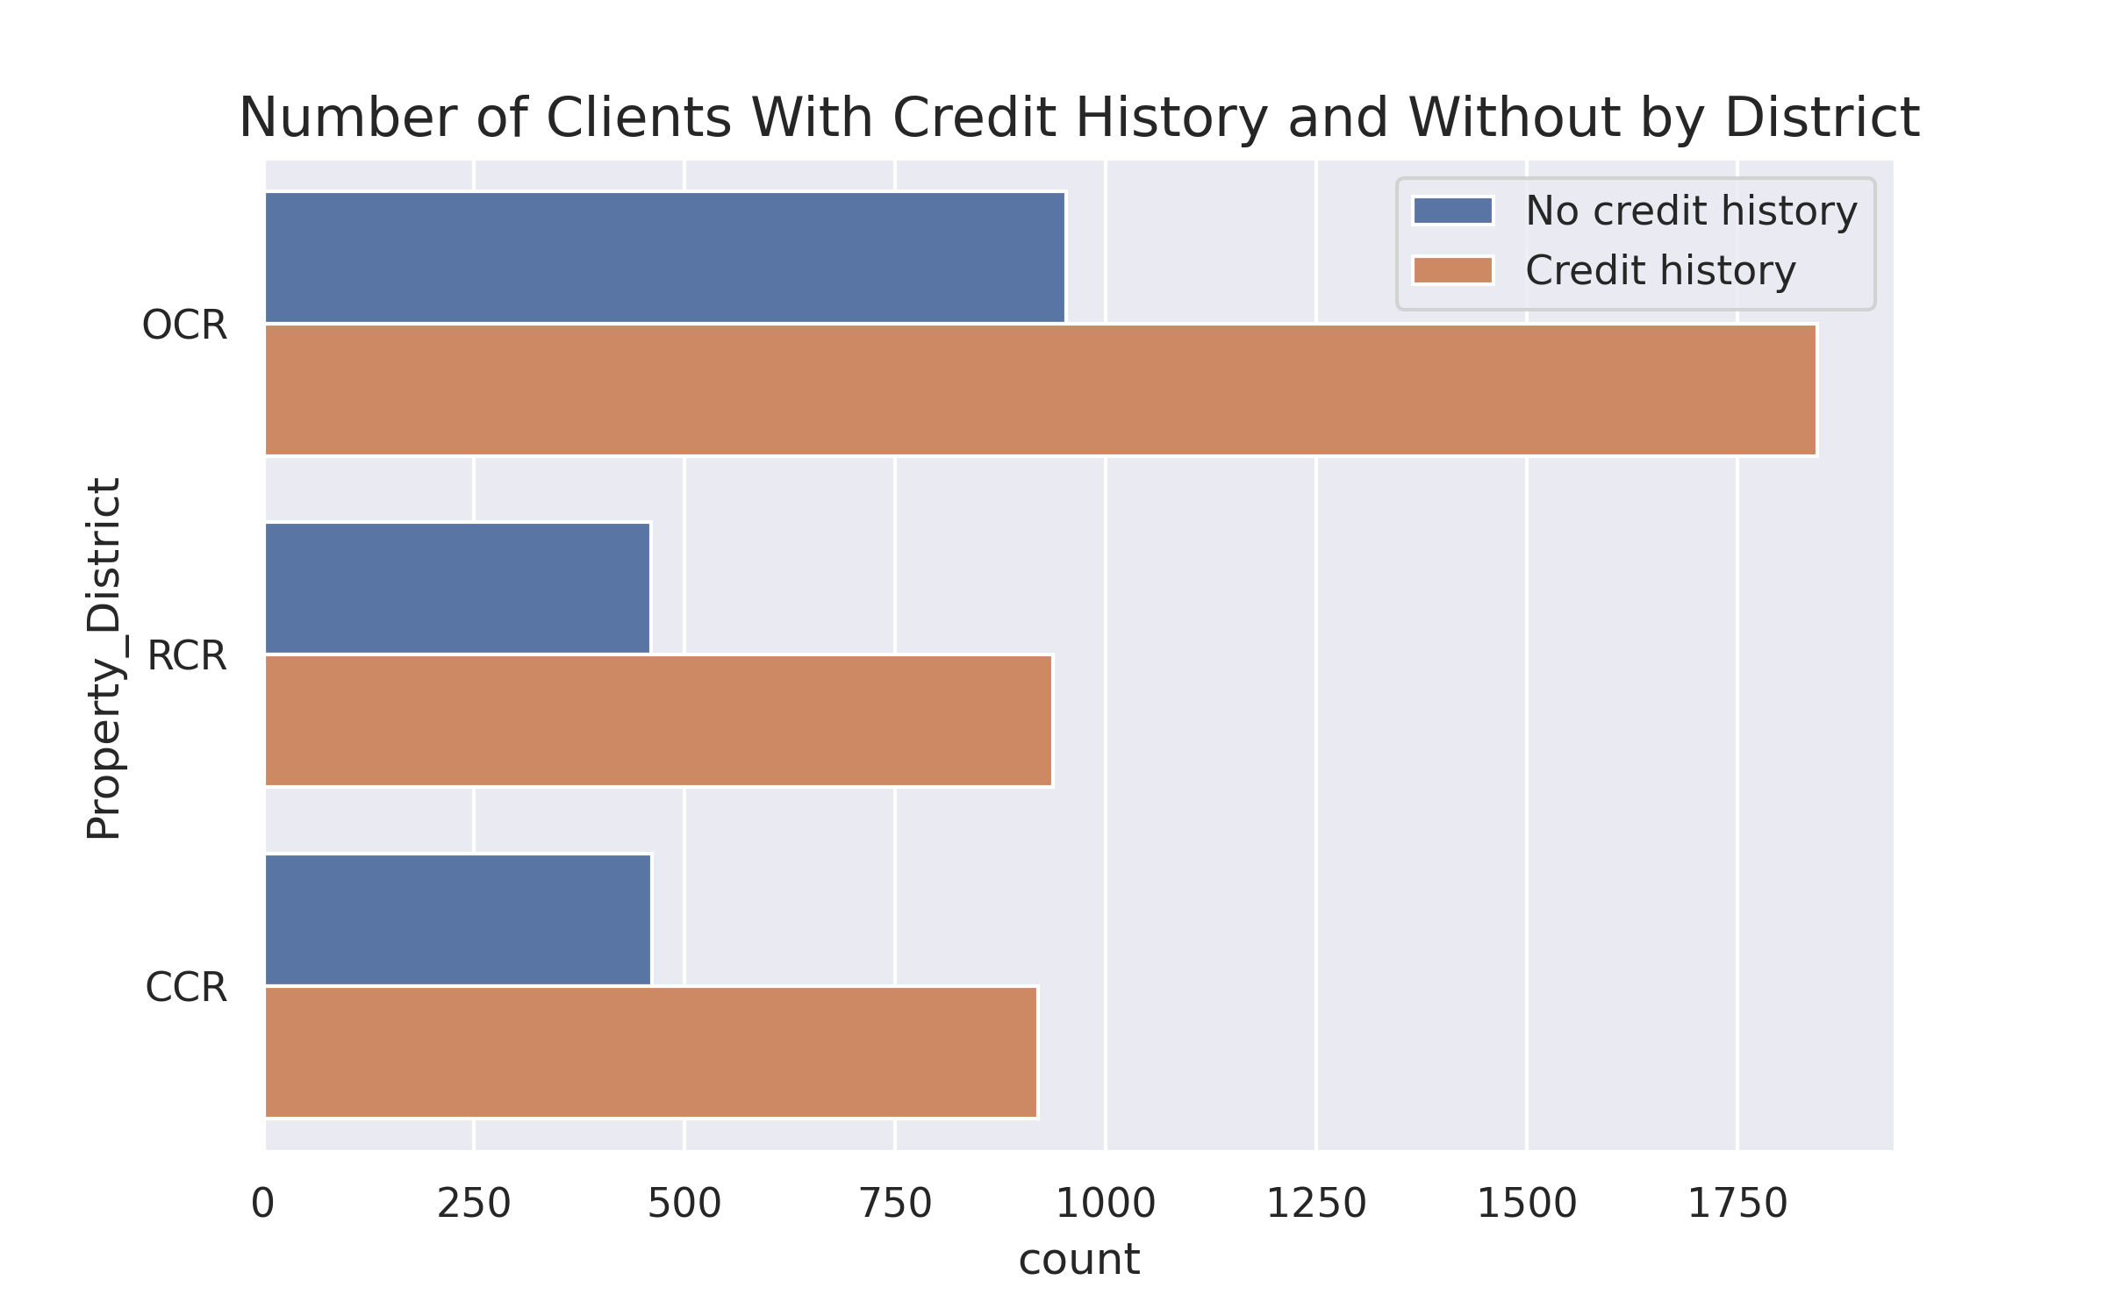
Credit history and number of clients by district
Clients in OCR:
Total: 2798 (50%)
Credit history: 1845 (66%)
No credit history: 953 (34%)
RCR:
Total: 1397 (25%)
Credit history: 920 (67%)
No credit history: 461 (33%)
CCR:
Total: 1381 (25%)
Credit history: 937 (67%)
No credit history: 460 (33%)

Slide 5
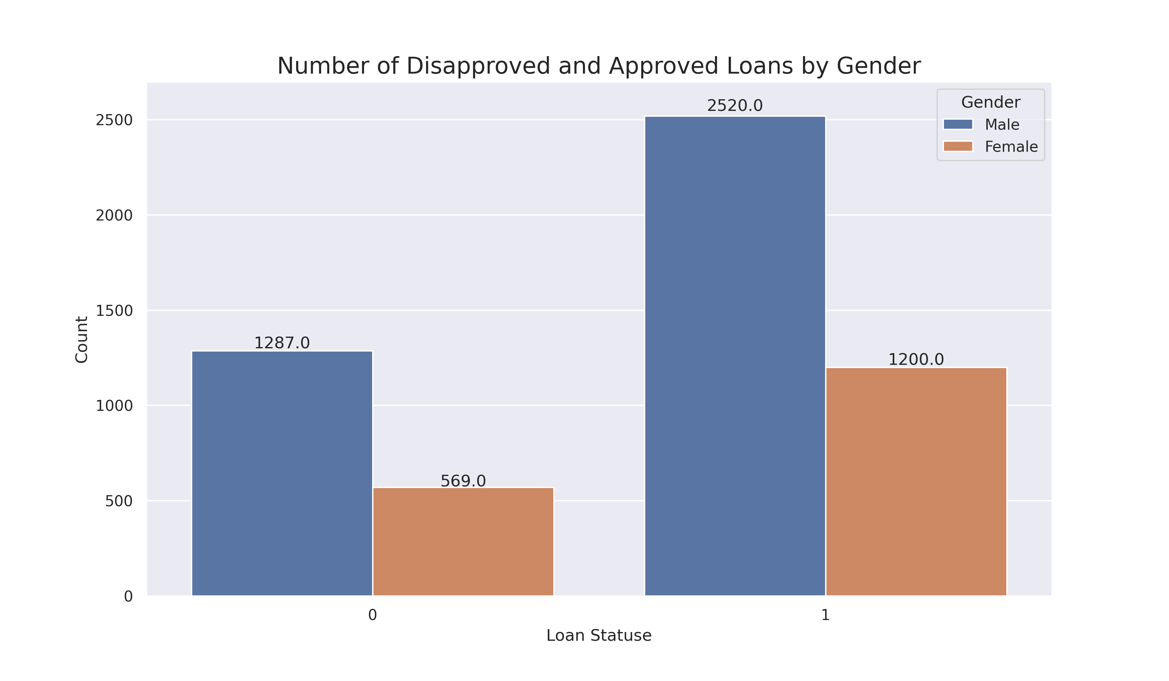
Number of Disapproved and Approved Loans by Gender
70% of clients are male
67% of Loans get approved
Disapproved:
Male – 70%
Female – 30%
Approved:
Male – 68%
Female – 32%

Slide 6
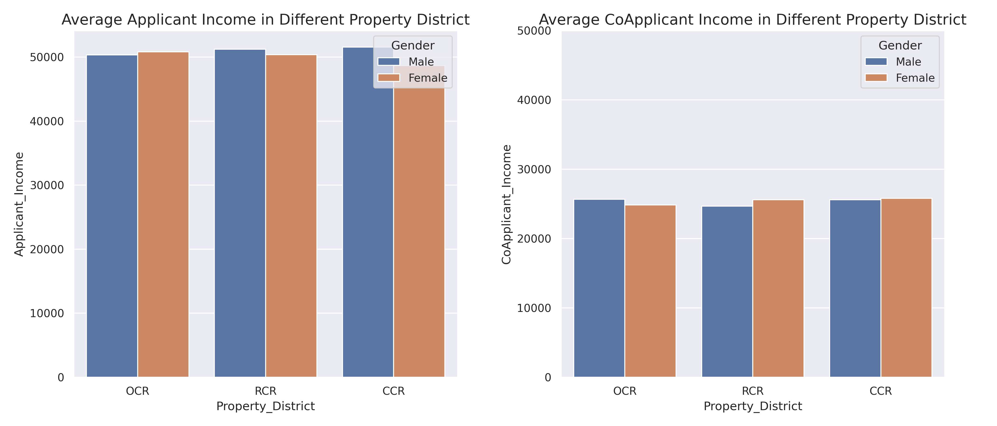
Average Applicant and co-applicant income in different Districts

Slide 7
MACHINE Learning Models used for predictions
KNN, Random Forest, LGBM Classifier, SMOTE with Logistic Regression, SMOTE with Random Forest
FINAL MODEL - Random Forest
Predicted 28% of Loans that will be Disapproved
73 % of Loans that will be Approved
Overall predicted correctly 58% of Data

Slide 8
Recommendations
Model needs improvements before implementation:
Re-consider the application process in order to eliminate the lack of critical data required for adjudication by making certain fields as mandatory
Extend the application to include additional information about:
purpose of the loan
collateral available to secure the loan
debt-to-income ratio

Slide 9
Thank you

